Slide 1
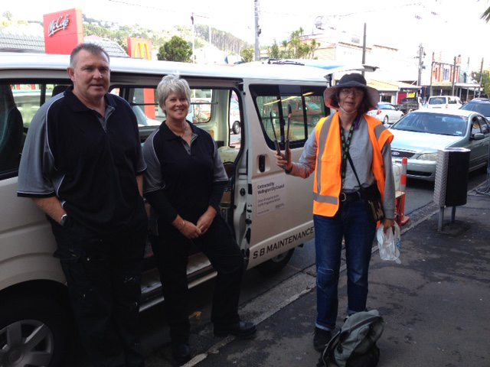
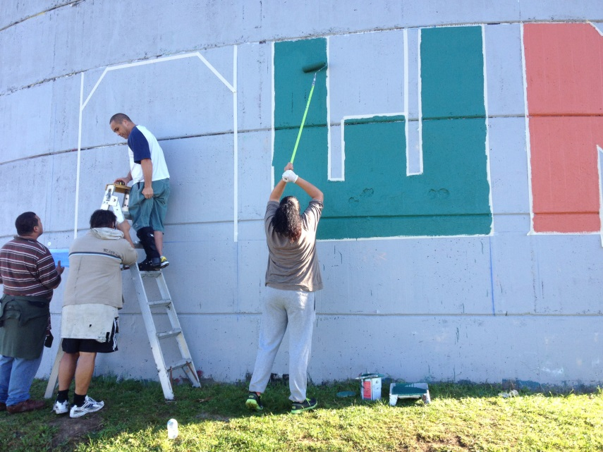
Keep Newtown clean project

Slide 2
Background:
  Initiated by the community with the first event held on Saturday 6 July 2013
  Developed to tackle the ‘tagging’ and discarded rubbish concerns
  Also to restore pride in the community
  Volunteers met on the first Saturday of each month
  Tasks are identified and allocated by the Wellington City Council contractor, SB Maintenance
  Has been supported by:
    Newtown Residents’ Association
    Newtown Business Group
    New World Newtown
    Newtown Community and Cultural Centre
    Wellington Timebank
    Wellington City Council

Slide 3
Where are we now?
  Less of a need for grafitti removal
  Decreasing numbers of volunteers – Fatigue? Too frequent?
  A lot of coordination work for the one volunteer currently coordinating this
New Approach:
  Increased focus on other aspects of keeping Newtown clean, building sense of pride, improving our environment but planting and adding murals
  Change from monthly events, to four per year
  Create new Keep Newtown Clean Coordinator role(s)
  Possibility of bringing Keep Newtown Clean under Newtown Residents’ Association Umbrella

Slide 4
  Commences September 2015
  First Saturday of the month: September, December, June
  Weekend prior to the Newtown Festival: February
Spring Planting
Summer Growth
Harvest
Fruit Trees
September 2015:
Keep Newtown Clean:
graffiti, rubbish,
poster removal
From 9am
December 2015:
Keep Newtown Clean:
graffiti, rubbish,
poster removal
From 9am
February 2016:
Clean-up prior to
Newtown Festival:
Rubbish, graffiti, poster removal, urban gardens
9.00am – 3.00pm
June 2016:
Keep Newtown Clean:
graffiti, rubbish,
poster removal
From 9am
Encourage residents to report concerns

Slide 5

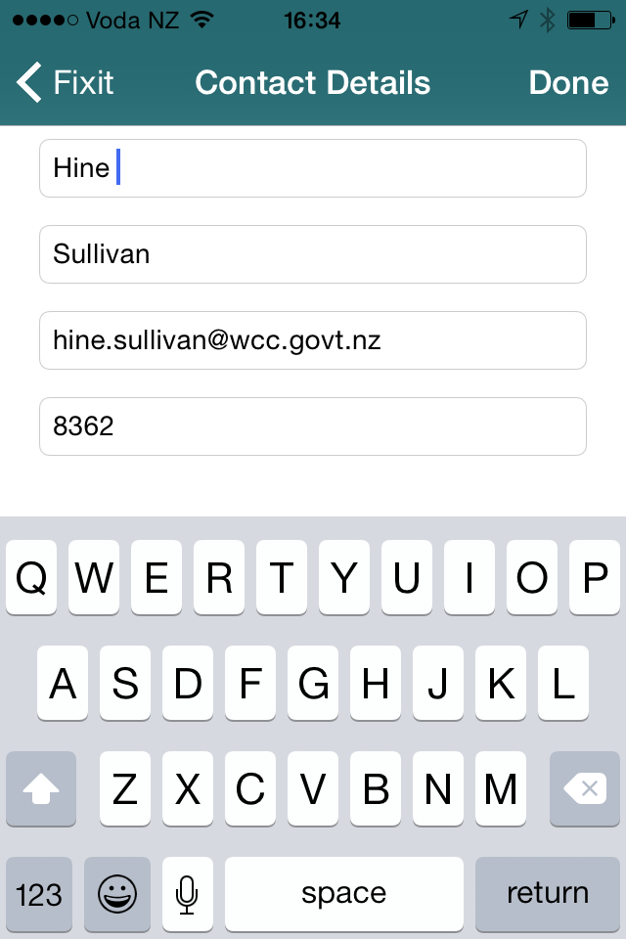
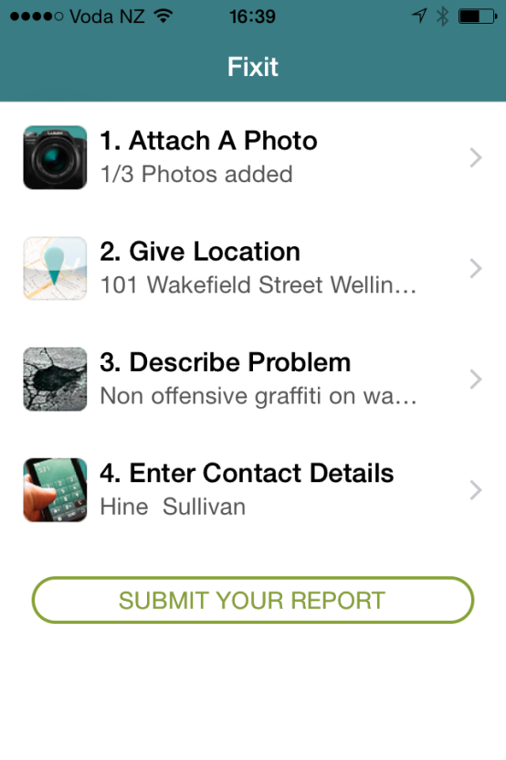
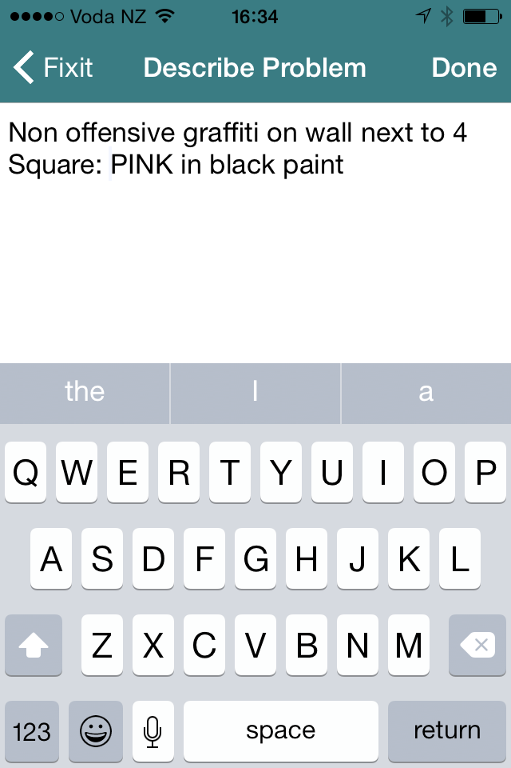
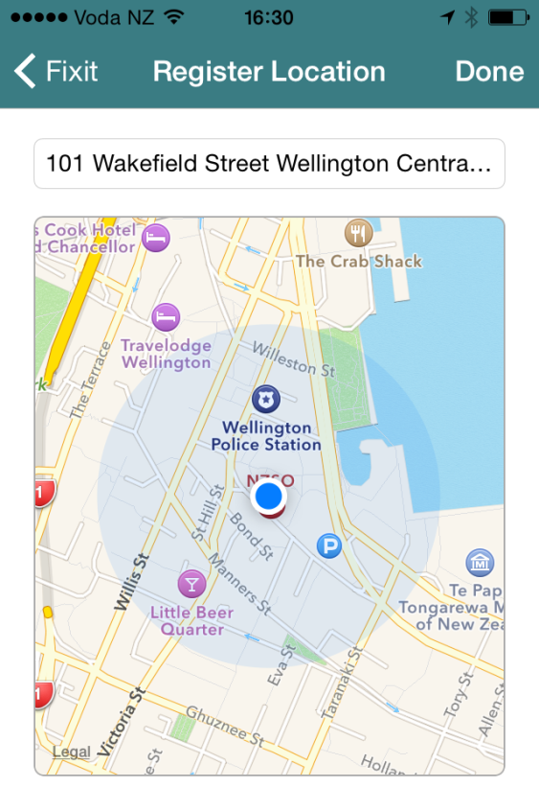
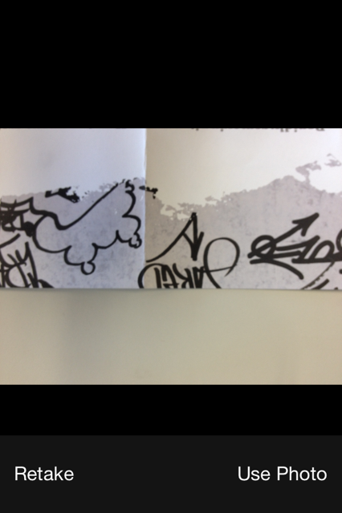
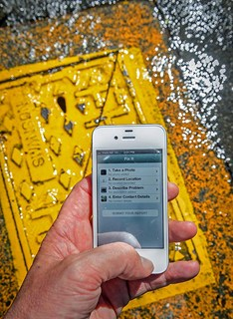
FIXiT App:
FIXiT is a free Smartphone app which gives Wellington residents and businesses another means of reporting problems they see, that need ‘fixing’.
E.G. Water leaks, missing manhole cover, graffiti, damaged street signs or street furniture, faulty street light, broken glass in a public place etc
How FIXiT works:
Take a photo
Confirm location
Describe the problem
Enter your details
SUBMIT YOUR REPORT
You will receive an email acknowledging receipt of your FIXiT, and the reference number.
Other reporting processes:
Phone: (04) 499 4444 (24/7)
Email: info@wcc.govt.nz
Text: 3400
Online: Fix It Requests

Slide 6
Wellington City Council Services
WCC Advisor
Provide information for social, Youth and Council services
Represent Council at various community group meetings:
  Youth
  Ethnic
  Migrant
  Pacific
  Residents’
Graffiti
Coordinates tasks for WCC Contractor
Provides information
Supports existing and new volunteer graffiti groups
Provide advice on removal/prevention/CPTED strategies
Coordinates Council response to graffiti concerns
Litter/Growth
Cut roadside & access way vegetation (annually & biannually)
Hard surface weed spraying (quarterly)
Residents cut growth pickup off the road reserve
Emptying bins, loose litter pickup, street sweeping, sump cleaning
Supply gloves, rubbish bags and collect full bags

Slide 7
Wellington City Council Services
City Arts
Provide advice on Mural processes
Provide details for suitable artists
Assist with funding advice
Assist to identify property owners to gain permission
Assist with community engagement
Council Housing
Build awareness of the project within City Housing communities
Display notices in City Housing complexes
Encourage tenants to engage in community related activities
Parks
Maintains and upgrades reserve walkways
Provides Parks and Gardens land owner approval
Assists environmental & restoration groups
Support from Park Rangers
Biodiversity management
Urban Gardens
Connects existing edible garden groups
Supports the development of these groups
Assist to scope available green space for gardens
External Relations
Provide marketing advice
Produce press releases if required
Promote the project across Council digital channels

Slide 8
What now?
Coordination of this process is necessary and we are seeking:
Keep Newtown Clean Coordinator(s) – Community Volunteer(s)
Advise/Coordinate/Recruit Volunteers
Encourage reporting concerns to WCC – FIXiT, text, phone, email, online
Arrange BBQ on the day
Update Volunteers on progress and dates for next clean-up
Advise WCC Graffiti team of areas that require attention at the next clean-up

